Slide 1
Training Image Classifiers
Explore ML

Slide 2

Recap: What is TensorFlow?
Notes:
Image
Answer on next slide

Slide 3
TensorFlow is a free and open-source software library for dataflow and differentiable programming
It is a symbolic math library, and can be used for machine learning applications such as neural networks.
Notes:
TensorFlow is not a new programming language. It's a library which means it can be used within your existing code. The purpose of the library is to make it easier to implement common mathematical functions from linear algebra and calculus.
Rather than have all data flow through a single algorithm, TensorFlow can process the data in parallel. This is essential for setting up a neural network with multiple nodes and layers.
Image from https://www.tensorflow.org/guide/graphs

Slide 4
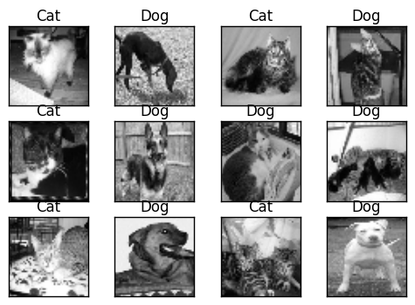
Notes:
Today, you will learn how to classify cats vs dogs images by using transfer learning from a pre-trained network.
Image from tutorial

Slide 5





General machine learning workflow
Collect Data
Predict and
Evaluate
Focus on User
Define Objective
Train and Test Model
Notes:
For today's activity, we're going to focus on a portion of the machine learning workflow.

Slide 6
Transfer Learning Updated
Explore Data
Predict
Evaluate
Reuse Pretrained
Model
Retrain Classification Layers
Notes:
Here is an overview of what we will work on today.
In this session you will create an Image Classification model. Rather than create the model from scratch, you'll reuse the pre-trained ImageNet model.

Slide 7
What is a pre-trained model?
Notes:
Before we jump into a hands on exercise, first let’s define what pre-trained model is..
Anyone have ideas?
[Ask for responses. If they struggle, have them recap what a model is.]

Slide 8
A pre-trained model is a saved network that was previously trained on a large dataset, typically for a large-scale image-classification task.
Notes:
One benefit of a pre-trained model is reusing a model others have created for the same task.

Slide 9
Transfer Learning
Output Labels
Output Labels
Source Model
Source Model
Source Data
New Data
(different domain)
Notes:
The exciting thing about pre-trained models is we can transfer learning from one pre-trained model to another task.
Similar to a human who learned to play piano, transferring some of that knowledge and skill to guitar.
The intuition behind transfer learning is that if a model trained on a large and general enough dataset, this model will effectively serve as a generic model of the visual world. You can then take advantage of these learned feature maps without having to start from scratch training a large model on a large dataset.
In this coding activity, you will try two ways to customize a pretrained model:
Feature Extraction: Use the representations learned by a previous network to extract meaningful features from new samples. You simply add a new classifier, which will be trained from scratch, on top of the pretrained model so that you can repurpose the feature maps learned previously for our dataset.
You do not need to (re)train the entire model. The base convolutional network already contains features that are generically useful for classifying pictures. However, the final, classification part of the pretrained model is specific to original classification task, and subsequently specific to the set of classes on which the model was trained.
Fine-Tuning: Unfreezing a few of the top layers of a frozen model base and jointly training both the newly-added classifier layers and the last layers of the base model. This allows us to "fine tune" the higher-order feature representations in the base model in order to make them more relevant for the specific task.

Slide 10

Image Classification Coding Activity
https://www.tensorflow.org/beta/tutorials/images/transfer_learning
Open the exercise in Colab
Sign in with your Google account
Activate the Runtime
Run code
Notes:
Let’s jump into the code!
Go to the exercise notebook
Open the exercise in Colab, a browser based notebook for running code in the cloud without needing to setup your computer.
Sign into your Google account (if it is their own account they can save the notebook in Drive to refer to later)
Activate the cloud-based runtime so you can run code in the cloud rather than setting up your machine
Run the code in a cell by clicking on the play/triangle button.

Slide 11
STOP
Do not present the following slides as a lecture.
They are for questions or a debrief after the activity.
Let learners work through the activity in pairs.

Slide 12
Import Libraries
from __future__ import absolute_import, division, print_function, unicode_literals
import os
import numpy as np
import matplotlib.pyplot as plt
Notes:
Let's setup our libraries first.

Slide 13
Install Tensorflow & add keras
!pip install -q tensorflow-gpu==2.0.0-beta1
import tensorflow as tf
keras = tf.keras

Slide 14
Download Data
import tensorflow_datasets as tfds
tfds.disable_progress_bar()
This tfds package is the easiest way to load predefined data
Notes:
In this exercise, we will use TensorFlow Datasets to load the cats and dogs dataset.
This tfds package is the easiest way to load pre-defined data.
Extra info: If you have your own data, and are interested in importing using it with TensorFlow see loading image data

Slide 15
Split Data into Training, Testing, Validation Sets
Since "cats_vs_dog" doesn't define standard splits, use the subsplit feature to divide it into (train, validation, test) with 80%, 10%, 10% of the data respectively.
SPLIT_WEIGHTS = (8, 1, 1)
splits = tfds.Split.TRAIN.subsplit(weighted=SPLIT_WEIGHTS)
(raw_train, raw_validation, raw_test), metadata =
tfds.load('cats_vs_dogs', split=list(splits),
with_info=True, as_supervised=True)
The tfds.load method downloads and caches the data, and returns a tf.data.Dataset object.
Notes:
The tfds.load method downloads and caches the data, and returns a tf.data.Dataset object. These objects provide powerful, efficient methods for manipulating data and piping it into your model.
Since the "cats_vs_dog" code doesn't define standard splits, use the subsplit feature to divide it into (train, validation, test) with 80%, 10%, 10% of the data respectively.

Slide 16
Check your Dataset
print(raw_train)
print(raw_validation)
print(raw_test)
get_label_name = metadata.features['label'].int2str
for image, label in raw_train.take(2):
plt.figure()
plt.imshow(image)
plt.title(get_label_name(label))
Notes:
What do you think happen in the red box?
Answer: It show the first two images and labels from the training set.

Slide 17
Format the Data
IMG_SIZE = 160 # All images will be resized to 160x160
def format_example(image, label):
image = tf.cast(image, tf.float32)
image = (image/127.5) - 1
image = tf.image.resize(image, (IMG_SIZE, IMG_SIZE))
return image, label
Notes:
We want all the data to have the same size: 160x160
We changed the size by creating a function called format_example and pass the image and label for each image.
tf.image module help us to format the images size to the size we want.
Resize the images to a fixed input size, and rescale the input channels to a range of [-1,1]

Slide 18
Format the Data
train = raw_train.map(format_example)
validation = raw_validation.map(format_example)
test = raw_test.map(format_example)
Notes:
Apply the formatting it to all the datasets.

Slide 19
Shuffle and Batch the Data.
BATCH_SIZE = 32
SHUFFLE_BUFFER_SIZE = 1000
train_batches = train.shuffle(SHUFFLE_BUFFER_SIZE)
.batch(BATCH_SIZE)
validation_batches = validation.batch(BATCH_SIZE)
test_batches = test.batch(BATCH_SIZE)
Notes:
We want the model to learn general patterns, not coincidental patterns because of the way the data is arranged. To avoid the issue we'll shuffle the data and bundle it into groups to keep the model from fixating on unintentional patterns.
Then apply the batches to all of the datasets.

Slide 20
Check & Inspect the Data.
for image_batch, label_batch in train_batches.take(1):
pass
image_batch.shape
TensorShape([32, 160, 160, 3])
Notes:
What result you get from running this code?
I got TensorShape([32, 160, 160, 3])! You can see 160, 160 is the width and height for that sample image.

Slide 21
Create the Base Model from the Pre-Trained Convnets
IMG_SHAPE = (IMG_SIZE, IMG_SIZE, 3)
# Create the base model from the pre-trained MobileNet V2
base_model = tf.keras.applications.MobileNetV2(input_shape=IMG_SHAPE,
include_top=False,
weights='imagenet')
Notes:
First, you need to pick which layer of MobileNet V2 you will use for feature extraction. Obviously, the very last classification layer (on "top", as most diagrams of machine learning models go from bottom to top) is not very useful. Instead, you will follow the common practice to instead depend on the very last layer before the flatten operation. This layer is called the "bottleneck layer". The bottleneck features retain much generality as compared to the final/top layer.
First, instantiate a MobileNet V2 model pre-loaded with weights trained on ImageNet. By specifying the include_top=False argument, you load a network that doesn't include the classification layers at the top, which is ideal for feature extraction.

Slide 22
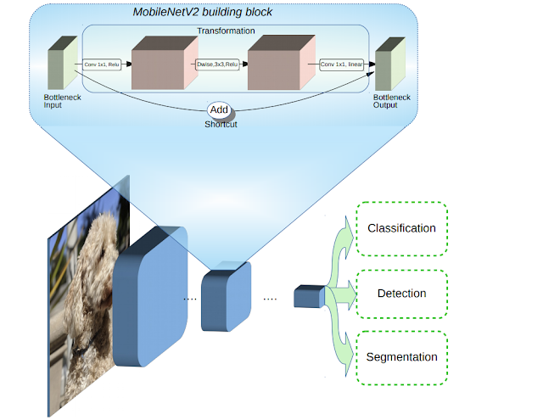
MobileNet V2
Notes:
You will create the base model from the MobileNet V2 model developed at Google. This is pre-trained on the ImageNet dataset, a large dataset of 1.4M images and 1000 classes of web images. ImageNet has a fairly arbitrary research training dataset with categories like jackfruit and syringe, but this base of knowledge will help us tell apart cats and dogs from our specific dataset.
Image from https://ai.googleblog.com/2018/04/mobilenetv2-next-generation-of-on.html

Slide 23
Feature Extraction
feature_batch = base_model(image_batch)
print(feature_batch.shape)
Notes:
You will freeze the convolutional base created from the previous step and use that as a feature extractor, add a classifier on top of it and train the top-level classifier.
This feature extractor converts each 160x160x3 image to a 5x5x1280 block of features. See what it does to the example batch of images:

Slide 24
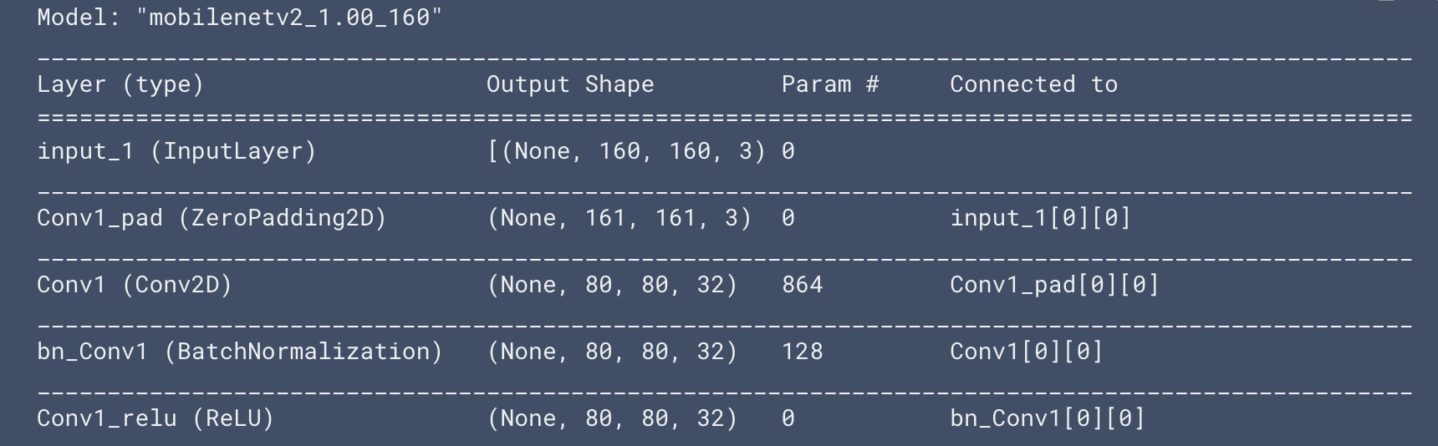
Freeze the Convolutional Base
base_model.trainable = False
# Let's take a look at the base model architecture
base_model.summary()
Notes:
It's important to freeze the convolutional based before you compile and train the model. By freezing (or setting layer.trainable = False), you prevent the weights in a given layer from being updated during training. MobileNet V2 has many layers, so setting the entire model's trainable flag to False will freeze all the layers.
That’s an example of result I get when I run that code

Slide 25
Add a Classification Head
global_average_layer = tf.keras.layers.GlobalAveragePooling2D()
feature_batch_average = global_average_layer(feature_batch)
print(feature_batch_average.shape)a
Notes:
To generate predictions from the block of features, average over the spatial 5x5 spatial locations, using a tf.keras.layers.GlobalAveragePooling2D layer to convert the features to a single 1280-element vector per image.

Slide 26
Add a Classification Head
prediction_layer = keras.layers.Dense(1)
prediction_batch = prediction_layer(feature_batch_average)
print(prediction_batch.shape)
Notes:
Apply a tf.keras.layers.Dense layer to convert these features into a single prediction per image. You don't need an activation function here because this prediction will be treated as a logit, or a raw prediction value. Positive numbers predict class 1, negative numbers predict class 0.

Slide 27
Stack the Feature Extractor
model = tf.keras.Sequential([
base_model,
global_average_layer,
prediction_layer
])
Notes:
Now stack the feature extractor, and these two layers using a tf.keras.Sequential model:

Slide 28
Compile the Model
base_learning_rate = 0.0001
model.compile(optimizer=tf.keras.optimizers
.RMSprop(lr=base_learning_rate),
loss='binary_crossentropy',
metrics=['accuracy'])
model.summary()

Slide 29
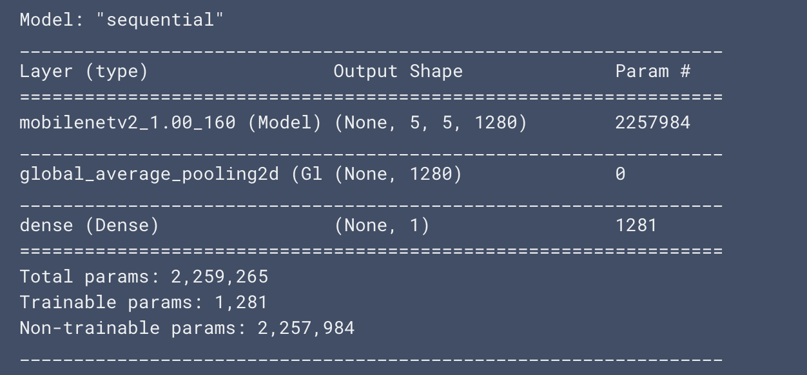
Result
Notes:
This is result I got after compiling the model.
Anyone can help me explain what happened here?

Slide 30
Compile the Model
len(model.trainable_variables)
Notes:
The 2.5M parameters in MobileNet are frozen, but there are 1.2K _trainable_ parameters in the Dense layer. These are divided between two `tf.Variable` objects, the weights and biases.

Slide 31
Train the Model
num_train, num_val, num_test = (
metadata.splits['train'].num_examples*weight / 10
for weight in SPLIT_WEIGHTS
)
initial_epochs = 10
steps_per_epoch = round(num_train) //BATCH_SIZE
validation_steps = 20
loss0, accuracy0 = model.evaluate(validation_batches,
steps = validation_steps)
Notes:
What result did you get?
Spend time refining the code to improve your result.

Slide 32
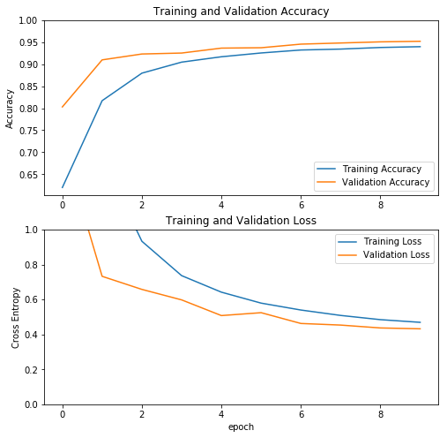
Notes:
Note: If you are wondering why the validation metrics are clearly better than the training metrics, the main factor is because layers like tf.keras.layers.BatchNormalization and tf.keras.layers.Dropout affect accuracy during training. They are turned off when calculating validation loss.
To a lesser extent, it is also because training metrics report the average for an epoch, while validation metrics are evaluated after the epoch, so validation metrics see a model that has trained slightly longer.
Images from output of tutorial

Slide 33
Fine Tuning
Notes:
In our feature extraction experiment, you were only training a few layers on top of an MobileNet V2 base model. The weights of the pre-trained network were not updated during training.
One way to increase performance even further is to train (or "fine-tune") the weights of the top layers of the pre-trained model alongside the training of the classifier you added. The training process will force the weights to be tuned from generic features maps to features associated specifically to our dataset.
Note: This should only be attempted after you have trained the top-level classifier with the pre-trained model set to non-trainable. If you add a randomly initialized classifier on top of a pre-trained model and attempt to train all layers jointly, the magnitude of the gradient updates will be too large (due to the random weights from the classifier) and your pre-trained model will forget what it has learned.
Also, you should try to fine-tune a small number of top layers rather than the whole MobileNet model. In most convolutional networks, the higher up a layer is, the more specialized it is. The first few layers learn very simple and generic features which generalize to almost all types of images. As you go higher up, the features are increasingly more specific to the dataset on which the model was trained. The goal of fine-tuning is to adapt these specialized features to work with the new dataset, rather than overwrite the generic learning.

Slide 34
Unfreeze the Top Layers of the Model
base_model.trainable = True
# Let's take a look to see how many layers are in the base model
print("Number of layers in the base model: ", len(base_model.layers))
# Fine tune from this layer onwards
fine_tune_at = 100
# Freeze all the layers before the `fine_tune_at` layer
for layer in base_model.layers[:fine_tune_at]:
layer.trainable = False
Notes:
All you need to do is unfreeze the base_model and set the bottom layers be un-trainable. Then, you should recompile the model (necessary for these changes to take effect), and resume training.

Slide 35
Re-Compile the Model
model.compile(loss='binary_crossentropy',
optimizer = tf.keras.optimizers
.RMSprop(lr=base_learning_rate / 10),
metrics=['accuracy'])
model.summary()
len(model.trainable_variables)
Notes:
Compile the model using a much lower training rate.

Slide 36
Unfreeze the Top Layers of the Model
fine_tune_epochs = 10
total_epochs = initial_epochs + fine_tune_epochs
history_fine = model.fit(train_batches,
epochs=total_epochs,
initial_epoch = initial_epochs,
validation_data=validation_batches)
Notes:
If you trained to convergence earlier, you will get a few percent more accuracy.

Slide 37
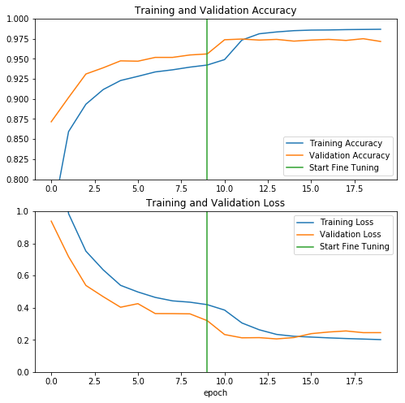
Notes:
Images from output of tutorial

Slide 38
Debrief
Benefits of Using a pre-trained model for feature extraction?
Options for fine-tuning a pre-trained model?
Notes:
Benefits of Using a pre-trained model for feature extraction?
Do not need to retrain a model. Only need to train the top layers for the specific task
Feature Extraction: Can reuse what the model learned about the original task it was trained for.
Options for fine-tuning a pre-trained model?
Lock lower layers and retrain the model on the new data.

